Slide 1

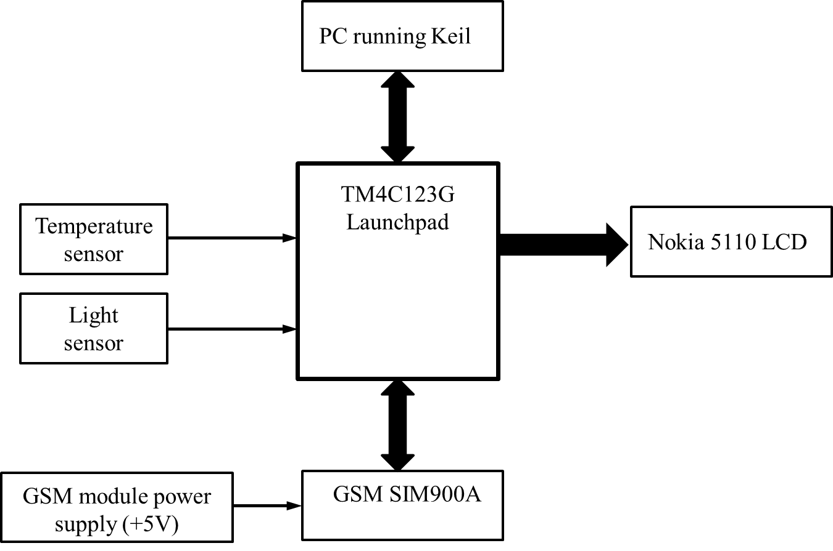
Power Conscious Sensor-based Remote Home Monitoring System through IoT
Ali Attaran ENGR 844 Project
Professor Dr. Xiaorong Zhang
May 2017

Slide 2
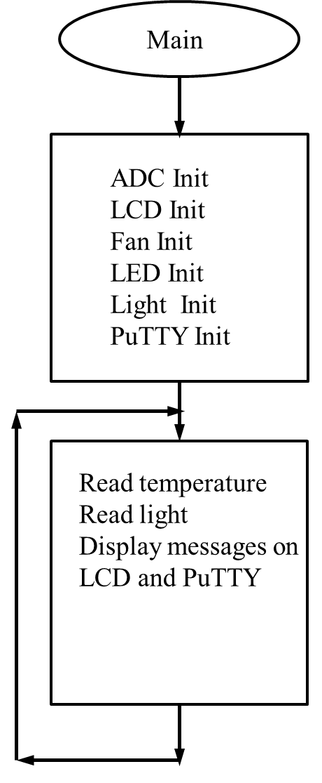
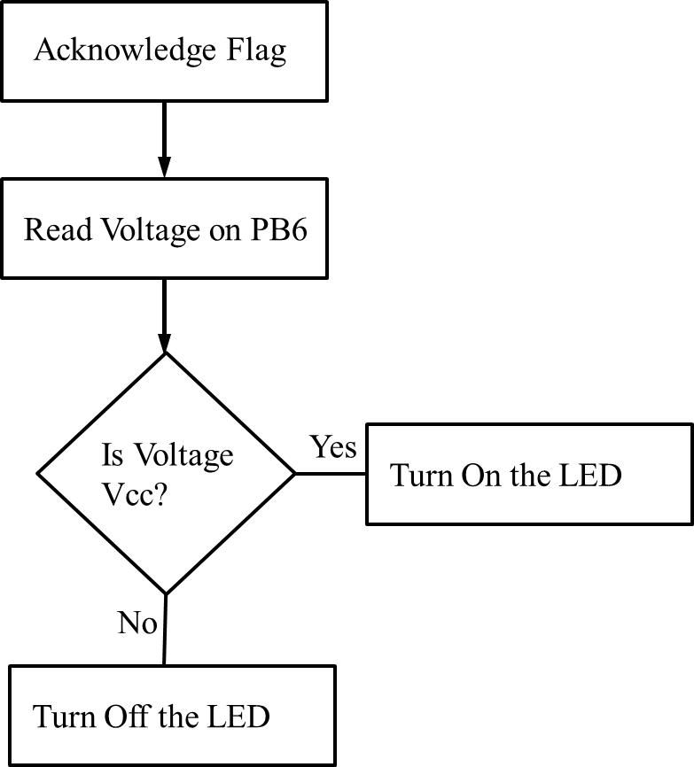
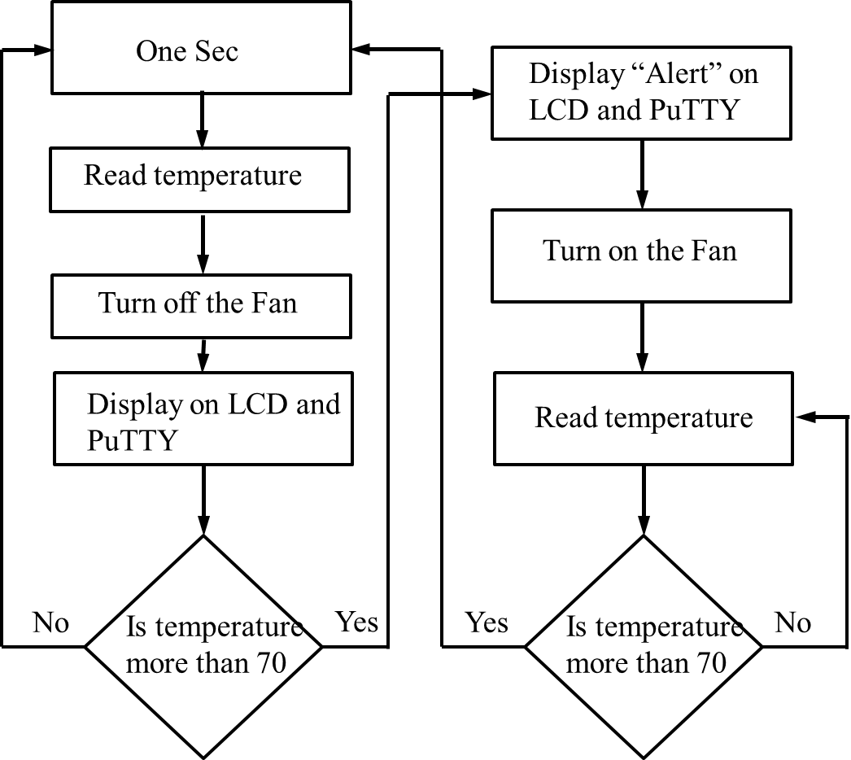
Flow chart
Temperature sensor
Light sensor

Slide 3
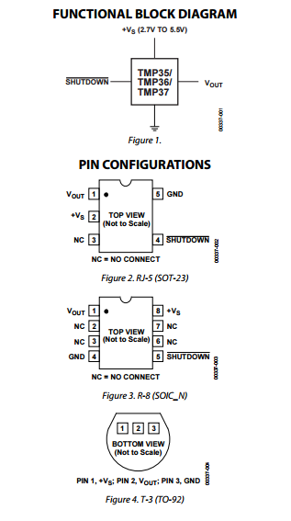
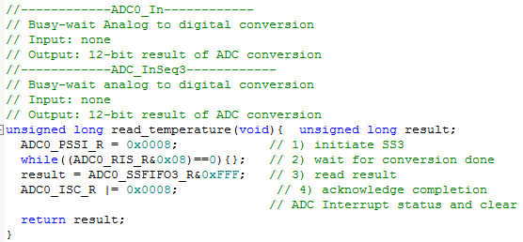
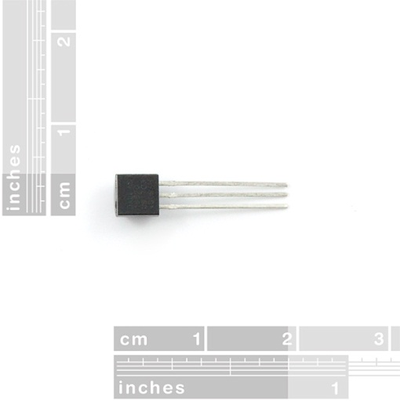
Temperature sensor Interface (1)
2cm
Pin E2 (V)
300m
320m
290m
240m
180m
210m
210m
For example at 180mV, ADCdata is (4096x180mV)/3300mV=223, So ADCdata will be 233 when temp sensor output is 180mV
At 70C, PE2 voltage will be
(70-25)X10mV+750mV=1100mV
Time (S)
1 2 3 4 5 6 7
Launchpad
+3.3V
150Ω
PN2222A
1
FAN
+12V
2
PE2
TMP36
PE1
R1
3

Slide 4
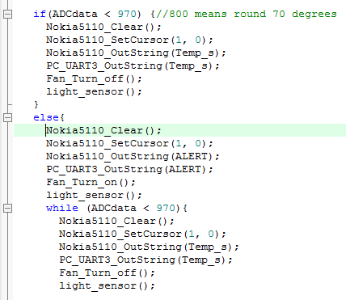
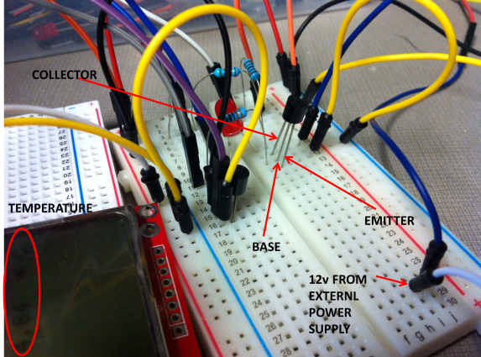
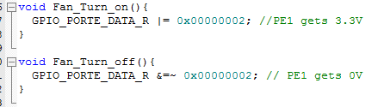
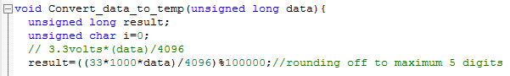
Temperature sensor Interface (2)
Launchpad
+3.3V
150Ω
PN2222A
1
FAN
+12V
2
PE2
TMP36
PE1
R1
3

Slide 5
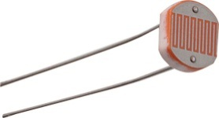
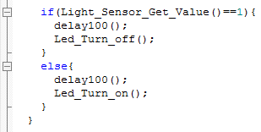
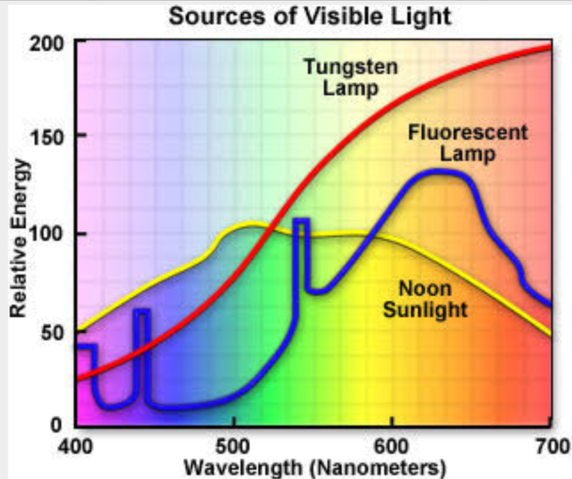
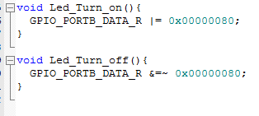
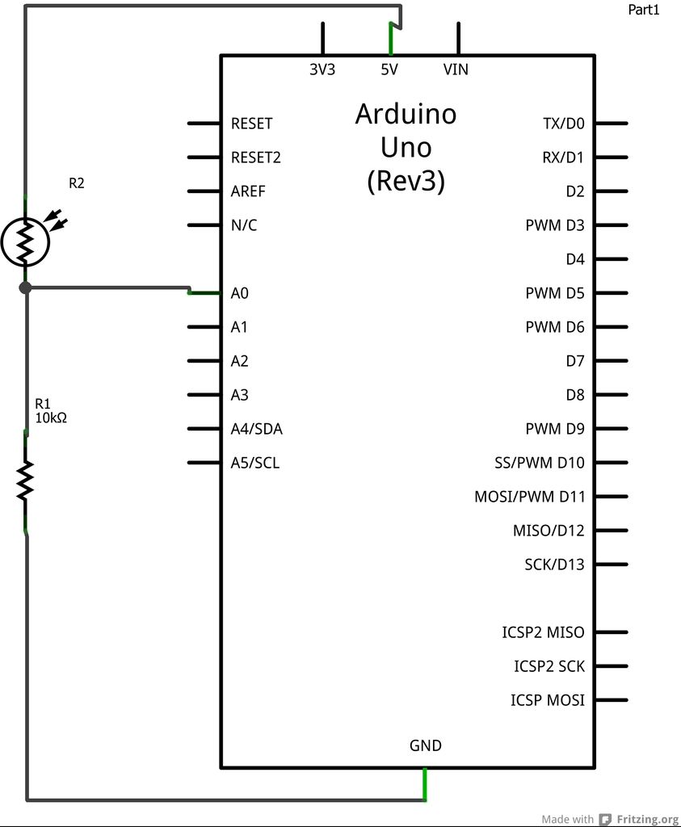
Light sensor Interface
Acknowledge Flag
Read Voltage on PB6
Is Voltage
Vcc?
Yes
Launchpad
Turn On the LED
3.3V
PB7
LDR
LED
When the light is on, Vout to be 3.3.
R high = 2MOhm
R low = 4kOhm
No
PB6
R2 = 39Ω
R3 = 150Ω
Turn Off the LED

Slide 6
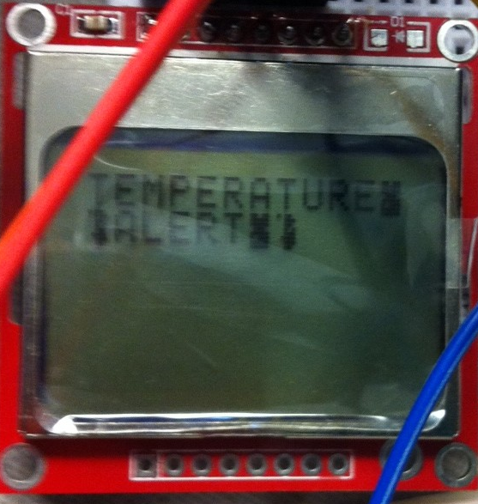
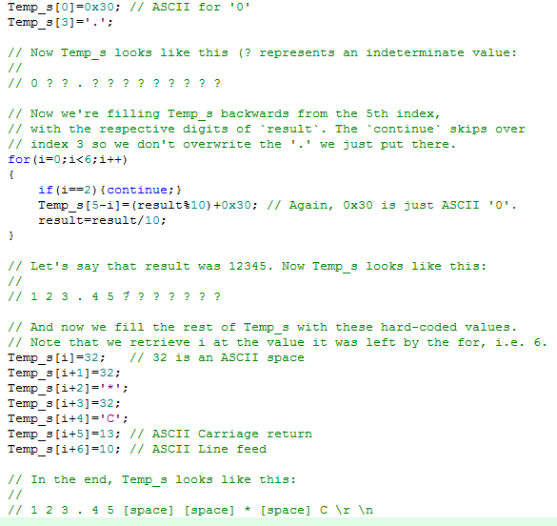
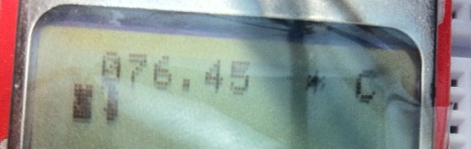
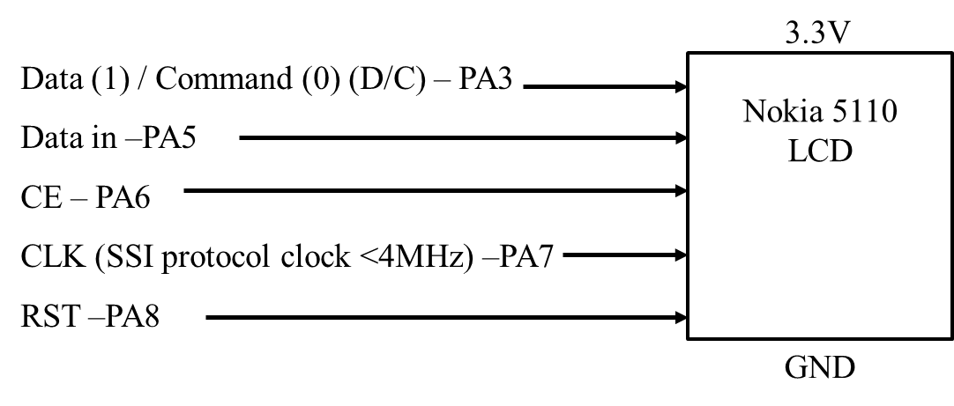
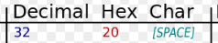
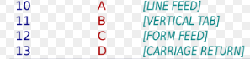
Nokia 5110 LCD Interface
'0' is ASCII 0x30
'1' is ASCII 0x31
'2' is ASCII 0x32
and so on.

Slide 7
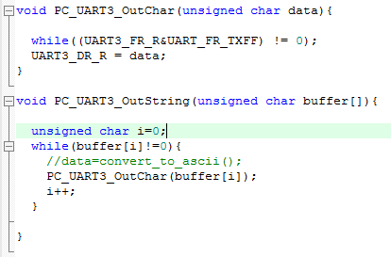
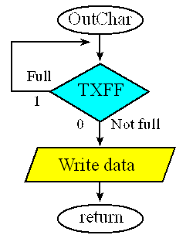
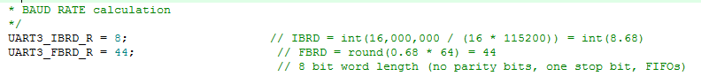
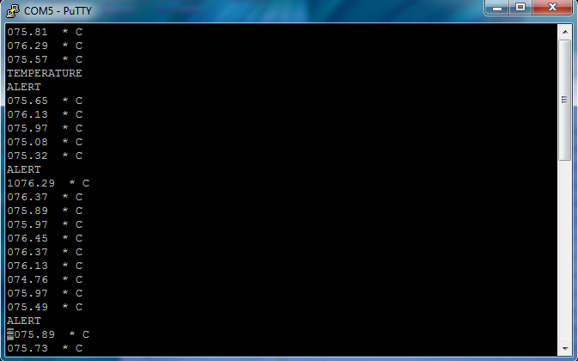
PuTTY Interface
UART buffers
2
8
.
7
6
°
C
UART TX buffer
28.76 °C
UART to USB converter (CP2102 USB to TTL)
Launchpad
PC
PC7
PC6
GND
Rx
Tx
GND
UART 3
USB cable

Slide 8
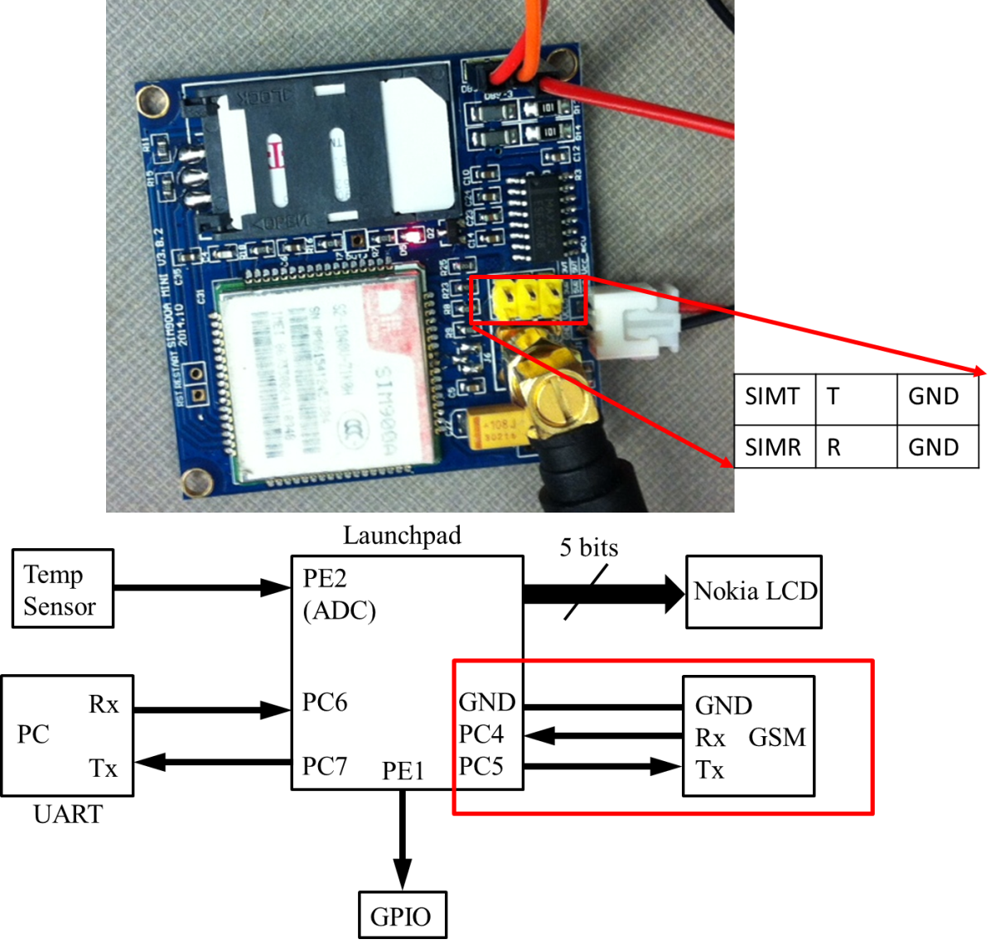
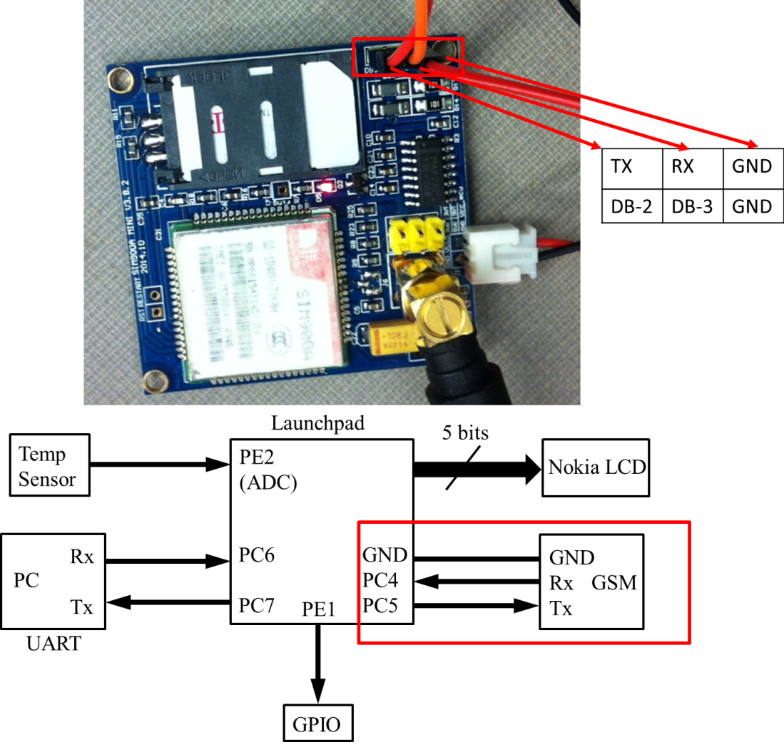
GSM SIM900A Modem Interface

Slide 9
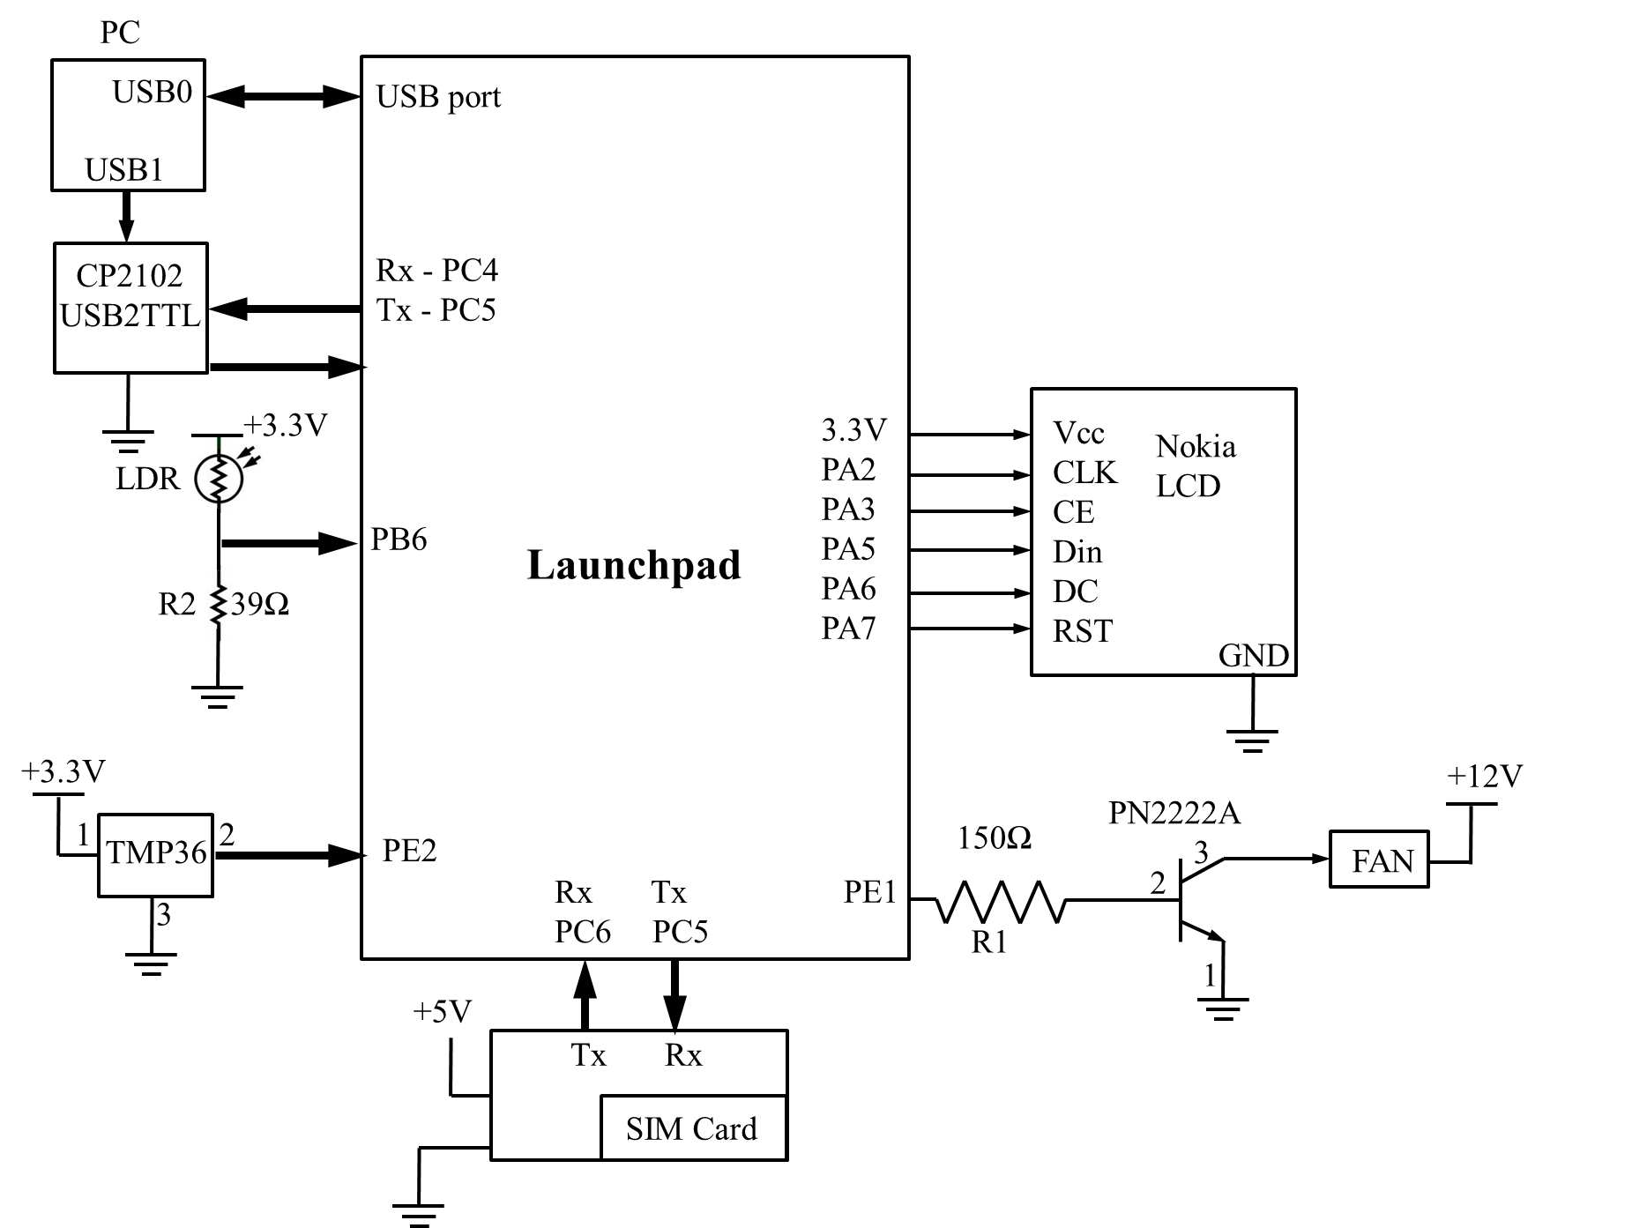
Complete schematic

